Slide 1

Wildcat Credit Union
Alex Ryse, Garrett Kraxberger, Victoria Cendejas Garibay

Slide 2
Overview
Introduction
Development Process
Key Learnings & Reflections
Tech Stack
Tools & Integrations
Key Features
Live Demo
Questions

Slide 3
Introduction
Full-stack banking web application designed to provide a secure and user-friendly experience
Includes account creation, fund management, and a unique ATM Locator feature
Goal: provide a reliable and locally-focused banking platform for the Central Washington University community in Ellensburg, WA

Slide 4
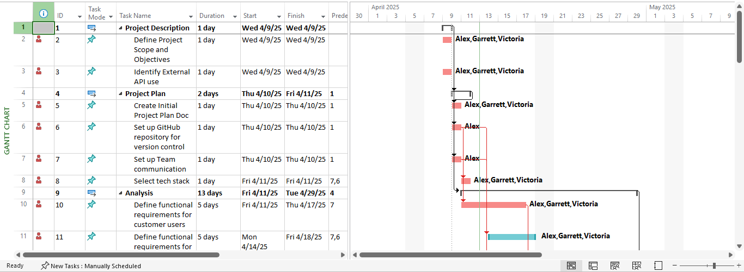
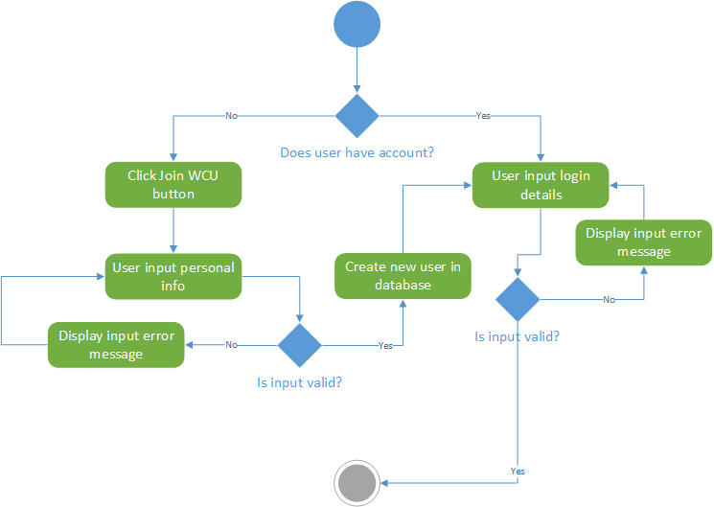


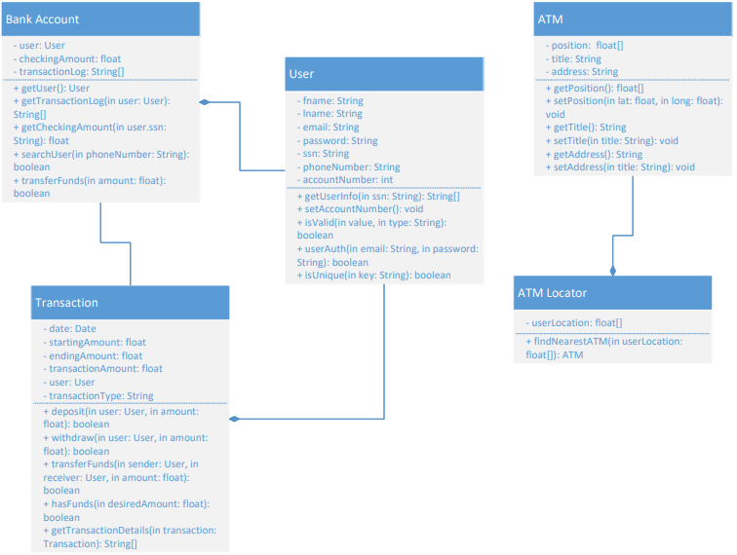
Development Process
Project Description
1
Project Plan
2
Analysis
3
Design
4
Testing
5
Implementation
6

Slide 5
Key Learnings & Reflections
Technical Growth & Problem Solving
Full stack integration, database management, debugging
Team Dynamics & Collaboration
Backend-frontend connection, communication, version control
SDLC & Project Management
Scope management, QA testing

Slide 6

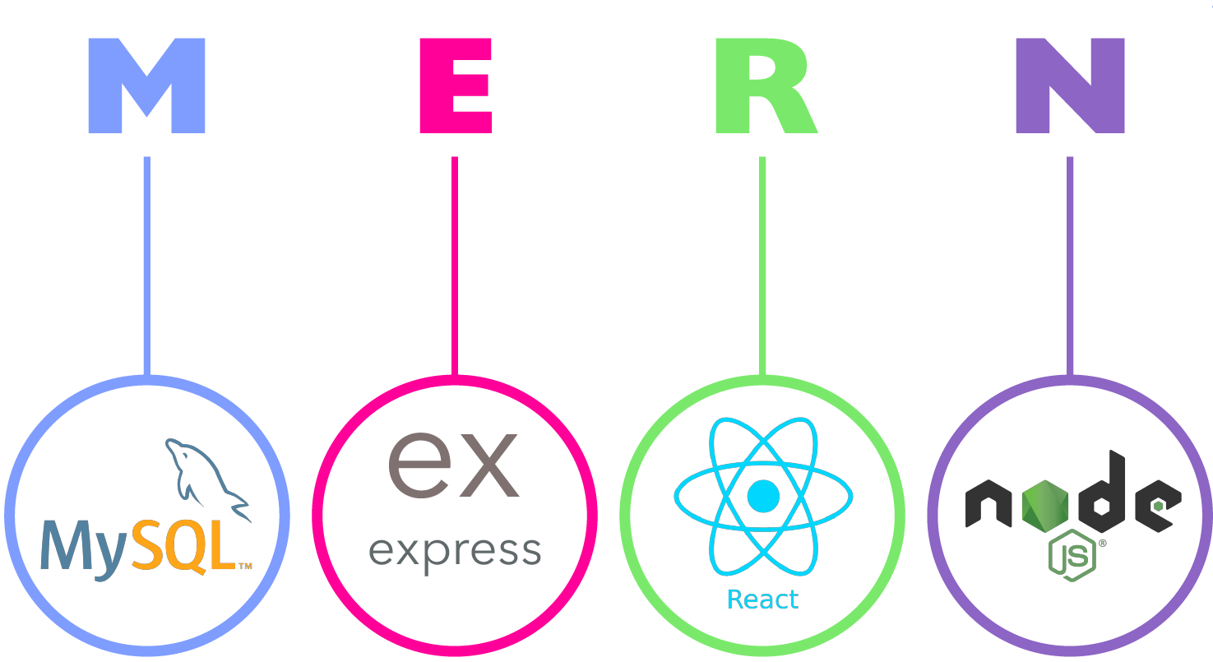
Tech Stack
Frontend:
React
Backend:
Node.js
Express.js
Database:
MySQL
Deployment & Environment:
Docker

Slide 7



Tools & Integrations
IDE:
VS Code
Version Control:
GitHub
API Integration:
Google Maps API

Slide 8
Key Features
Instant Fund Management
Password Encryption
Account Lockdown
Real-time User Location Display
Dynamic Map Interactions

Slide 9

Live Demo

Slide 10

Questions

